Slide 1
LAB SESSION 2
Stakeholders & Process Models

Slide 2
HOW TO IDENTIFY STAKEHOLDERS
Whether you do this yourself, or in a group comprising your core project team
(which is advised), you can help to kick start stakeholder identification by asking
the following questions in a brainstorming session:
Who is affected positively and negatively by the project?
The project mainly benefits the food truck owners in establishing their business in a wider manner. That is that the food truck owners now have a wider scope to do their business in and a their business reaches a lot of people. The people who will be affected negatively by this project include restaurant owners as this project provides services while sitting at home.
Who has the power to make it succeed (or fail)?
The success of this project entirely depends on the food truck owners and the customers, i.e., when the customers like the food provided by the food truck owners, they tend to provide better sales for them leading to either a success or a failure of this project.

Slide 3
Who makes the decisions about money?
All finance related matters are handled by the food truck owners themselves as they are the ones who decide the price of the dishes on the menu, how much to invest on the food truck, etc.
Who are the suppliers?
The suppliers include all the people from whom the owners buy all the ingredients from.
Who are the end users?
The end users are the customers because they are the ones who would end up buying from the owners buy using the website.
Who has influence over other stakeholders?
Big Restaurant and Café owners who are wealthy enough have influence over the stakeholders as they can advertise their restaurants in much better way.

Slide 4
EXAMPLE OF STAKEHOLDER
Project Name: Food truck website
Prepared by: Hemalatha T, Yukta Kasina, Srishti Singh
Date: 22/03/2022
Project Stakeholder’s Name | Specific Information Needs | Project Interests | Impact on Project | Role
1. Hemalatha T | hq4862@srmist.edu.in 9345723295 (Any Kind) | 1.Programming(C/C++/Python) 2.Web Development(front end) 3.Cybersecurity | Assignment of tasks to the members, creating layout of the project, implementing the project. | 1. Group Leader 2. Analyst 3. Developer.
2. Yukta Kasina | yk3599@srmist.edu.in 9908533357 (Any Kind) | Programming(C,C++,Python) Web development | Implementing the project, improving the project from team member’s feedback. | 1.Analyst 2.Developer

Slide 5
Project Stakeholder’s Name | Specific Information Needs | Project Interests | Impact on Project | Role
3. Srishti Singh | ss8677@srmist.edu.in 6392443113 (Any kind) | 1. Programming 2. Web development. | Implementing the project, Adding back end features to the project. | Analyst Developer

Slide 6
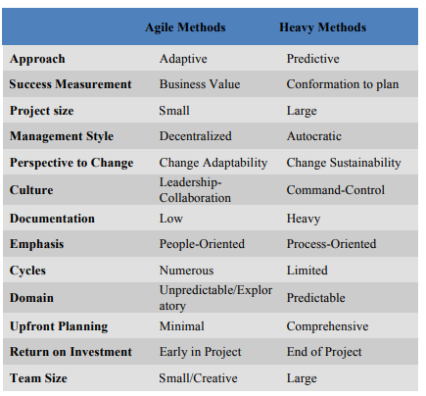
COMPARISON – AGILE AND HEAVY WEIGHT METHODOLOGIES

